Slide 1
Introduction to Computer Graphics with WebGL
Rendering Meshes
Angel and Shreiner: Interactive Computer Graphics 7E © Addison-Wesley 2015

Slide 2
Meshes
Polygonal meshes are the standard method for defining and displaying surfaces
  Approximations to curved surfaces
  Directly from CAD packages
  Subdivision
Most common are quadrilateral and triangular meshes
  Triangle strips and fans
Angel and Shreiner: Interactive Computer Graphics 7E © Addison-Wesley 2015

Slide 3
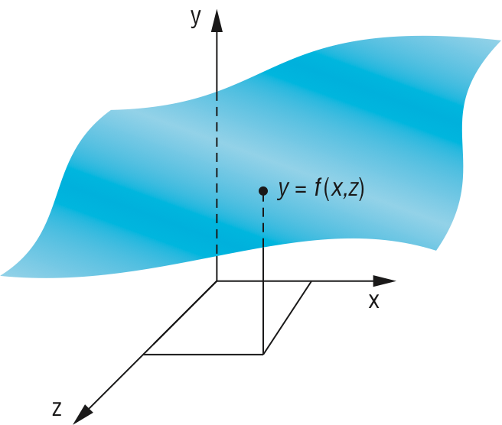
Height Field Meshes
For each (x, z) there is a unique y
Sampling leads to an array of y values
Display as quadrilateral or triangular mesh using strips
Angel and Shreiner: Interactive Computer Graphics 7E © Addison-Wesley 2015

Slide 4
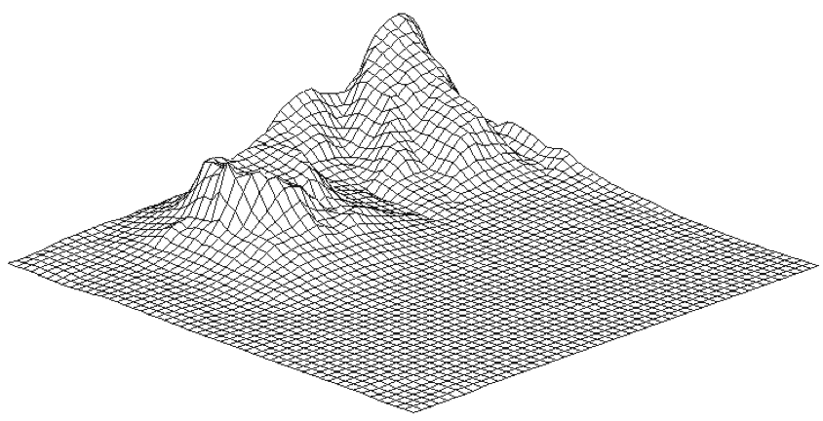
Honolulu Plot Using Line Strips
Angel and Shreiner: Interactive Computer Graphics 7E © Addison-Wesley 2015

Slide 5
Triangle Meshes
We can use each 3 adjacent points to form triangles. If we want grid lines we can fill the triangles with gl.TRIANGLE_STRIP, then add black lines with gl.LINE_loop:
for (var i = 0; i < numPolygons; ++i) {
gl.uniform4fv(fColor, faceColor );
gl.drawArrays(gl.TRIANGLE_STRIP, start[i], polyArray[i].length);
gl.uniform4fv(fColor, black);
for (var j = start[i]; j < polyArray[i].length-2; ++j)
gl.drawArrays(gl.LINE_LOOP, j, 3);
}
}
Angel and Shreiner: Interactive Computer Graphics 7E © Addison-Wesley 2015

Slide 6
Quadrilateral Meshes
We can use 4 adjacent points to form a quadrilateral and thus two triangles which can be shaded. If we want grid lines we can fill the triangles with gl.TRIANGLE_FAN, and then add black lines with gl.LINE_loop:
for (var i = 0; i < pointsArray.length; i += 4) {
gl.uniform4fv(fColor, faceColor );
gl.drawArrays(gl.TRIANGLE_FAN, i, 4);
gl.uniform4fv(fColor, black);
gl.drawArrays(gl.LINE_LOOP, i, 4);
}
Angel and Shreiner: Interactive Computer Graphics 7E © Addison-Wesley 2015

Slide 7
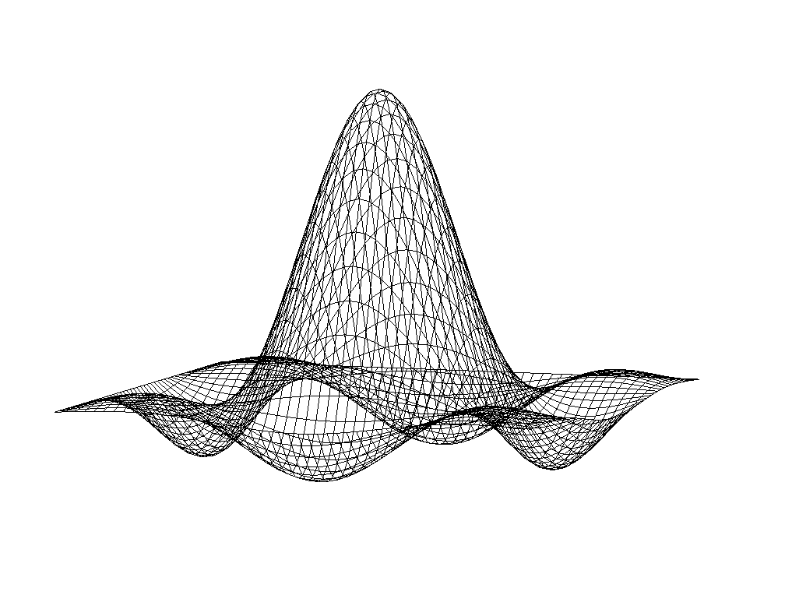
Lines on Back and Hidden Faces
Sombrero or Mexican Hat function: (sin πr)/(πr)
Angel and Shreiner: Interactive Computer Graphics 7E © Addison-Wesley 2015

Slide 8
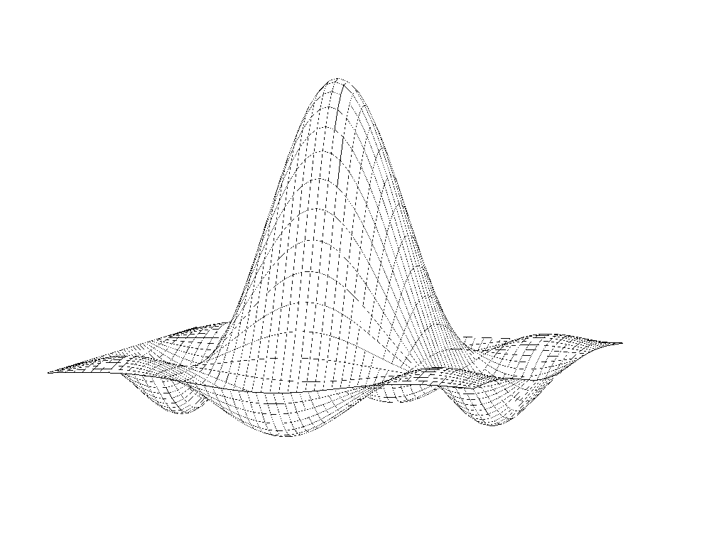
Hat Using Polygons and Lines
Angel and Shreiner: Interactive Computer Graphics 7E © Addison-Wesley 2015

Slide 9
Polygon Offset
Even though we draw the polygon first followed by the lines, small numerical errors cause some of fragments on the line to be display behind the corresponding fragment on the triangle
Polygon offset (gl.polygonOffset) moves fragments slight away from camera:
gl.enable(gl.POLYGON_OFFSET_FILL);
gl.polygonOffset(1.0, 1.0);
Angel and Shreiner: Interactive Computer Graphics 7E © Addison-Wesley 2015

Slide 10
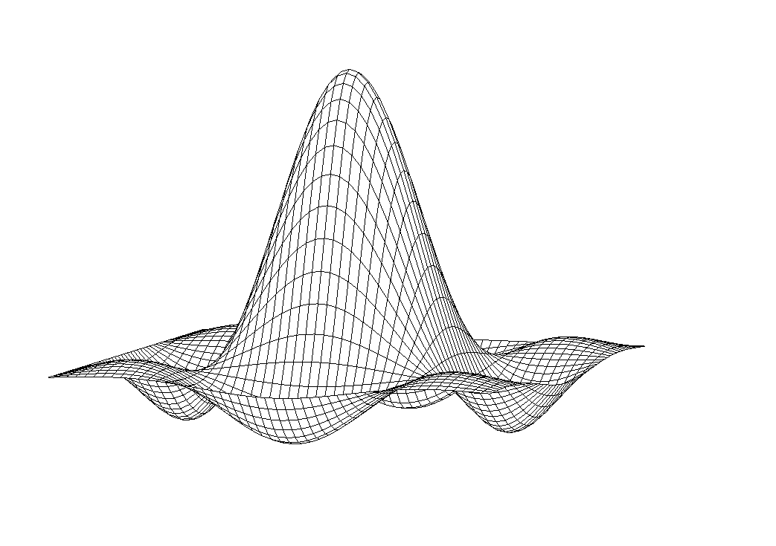
Hat with Polygon Offset
Angel and Shreiner: Interactive Computer Graphics 7E © Addison-Wesley 2015

